Slide 1
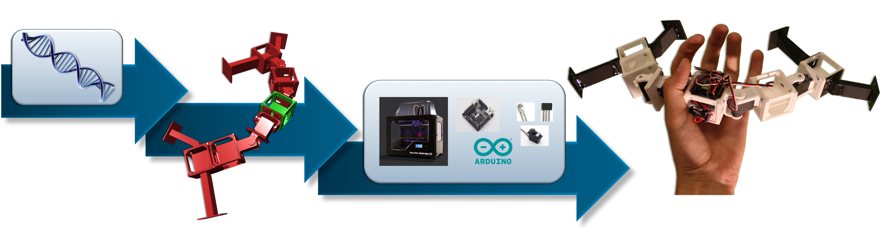
Evolutionary Robotics
Group 1

Slide 2
Task and Motivation
Robot following light
Convoy or Swarm of robots
- «Going back home» function implemented for only one robot
-
Simpler robot
Notes:
Each robot has a specific task: clean, dig etc.. And only one robot has the localization function implemented

Slide 3
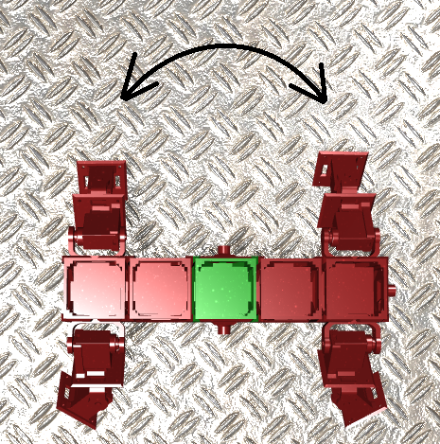
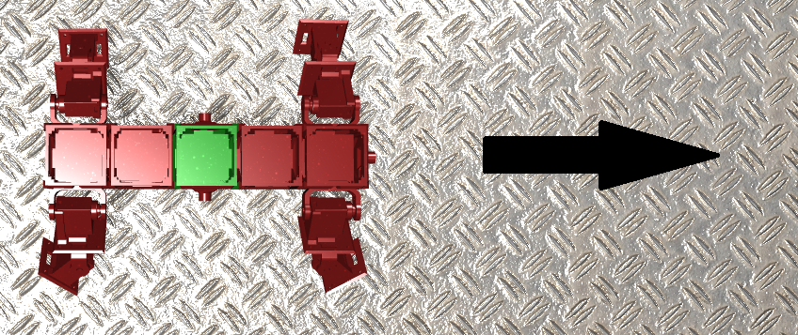
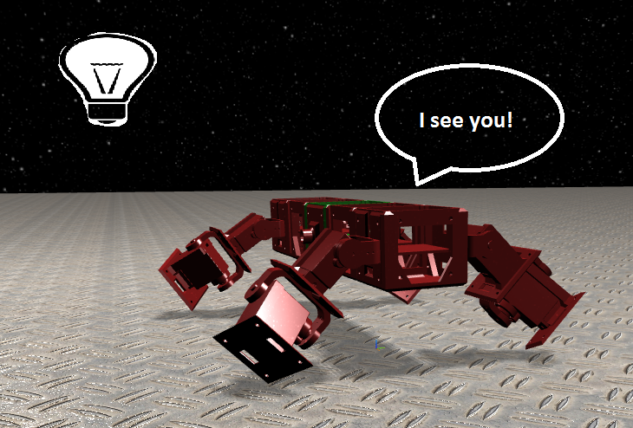
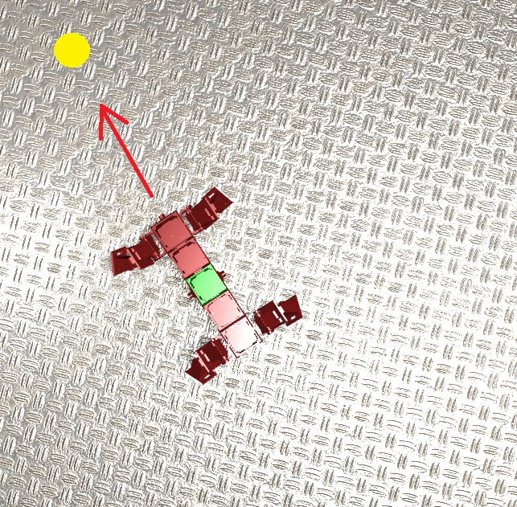
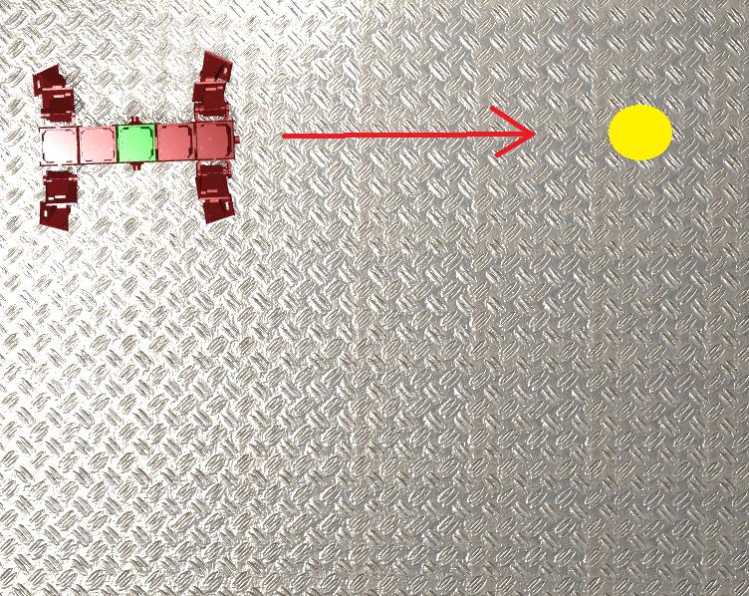
Evolution Steps
1. Linear displacement 2. Orientation towards a specific point
3. Detection of light and pursuit 4. Following a «moving» light

Slide 4
Morphology and Brain Evolution
Start from a defined morphology
Morphology inspired from nature
Brain evolved in the steps mentionned previously

Slide 5
First fitness function
Necessary parameters:
Starting position
Position of the core component and secondary component (for the orientation)
IR values
First fitness function:

Slide 6
First Results

